Slide 1


* I do not claim authorship for all texts and pictures in the presentation.
Introduction to Logic [Argument Structure]
Assistant Professor
Innopolis University

Slide 2
1. Intro
The study of logic dates back to Aristotle *syllogism, logical fallacies and other key concepts*
J. Locke gave logic its modern outlook
Definition: ‘LOGIC IS THE ANATOMY OF THOUGHT’
2

Slide 3
2. Recognising Arguments
Before giving a definition of what a logical argument is, let s try to understand the idea
Argument: attempt to persuade by evidence and reason
3

Slide 4
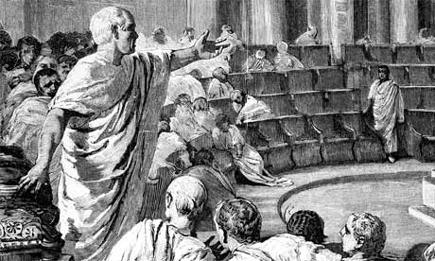
COMPARE IT WITH RHETORIC
Rhetor tend to manipulate people
YET: Rhetoric is not always bad or undesirable
4

Slide 5
‘The British Empire and the French Republic, linked together in their cause and in their need, will defend to the death their native soil, aiding each other like good comrades to the utmost of their strength. Even though large tracts of Europe and many old and famous States have fallen or may fall into the grip of the Gestapo and all the odious apparatus of Nazi rule, we shall not flag or fail.
We shall go on to the end, we shall fight in France, we shall fight on the seas and oceans, we shall fight with growing confidence and growing strength in the air, we shall defend our Island, whatever the cost may be, we shall fight on the beaches, we shall fight on the landing grounds, we shall fight in the fields and in the streets, we shall fight in the hills; we shall never surrender, and even if, which I do not for a moment believe, this Island or a large part of it were subjugated and starving, then our Empire beyond the seas, armed and guarded by the British Fleet, would carry on the struggle, until in God’s good time, the New World, with all its power and might, steps forth to the rescue and the liberation of the old’.
5

Slide 6
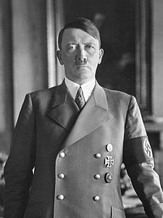
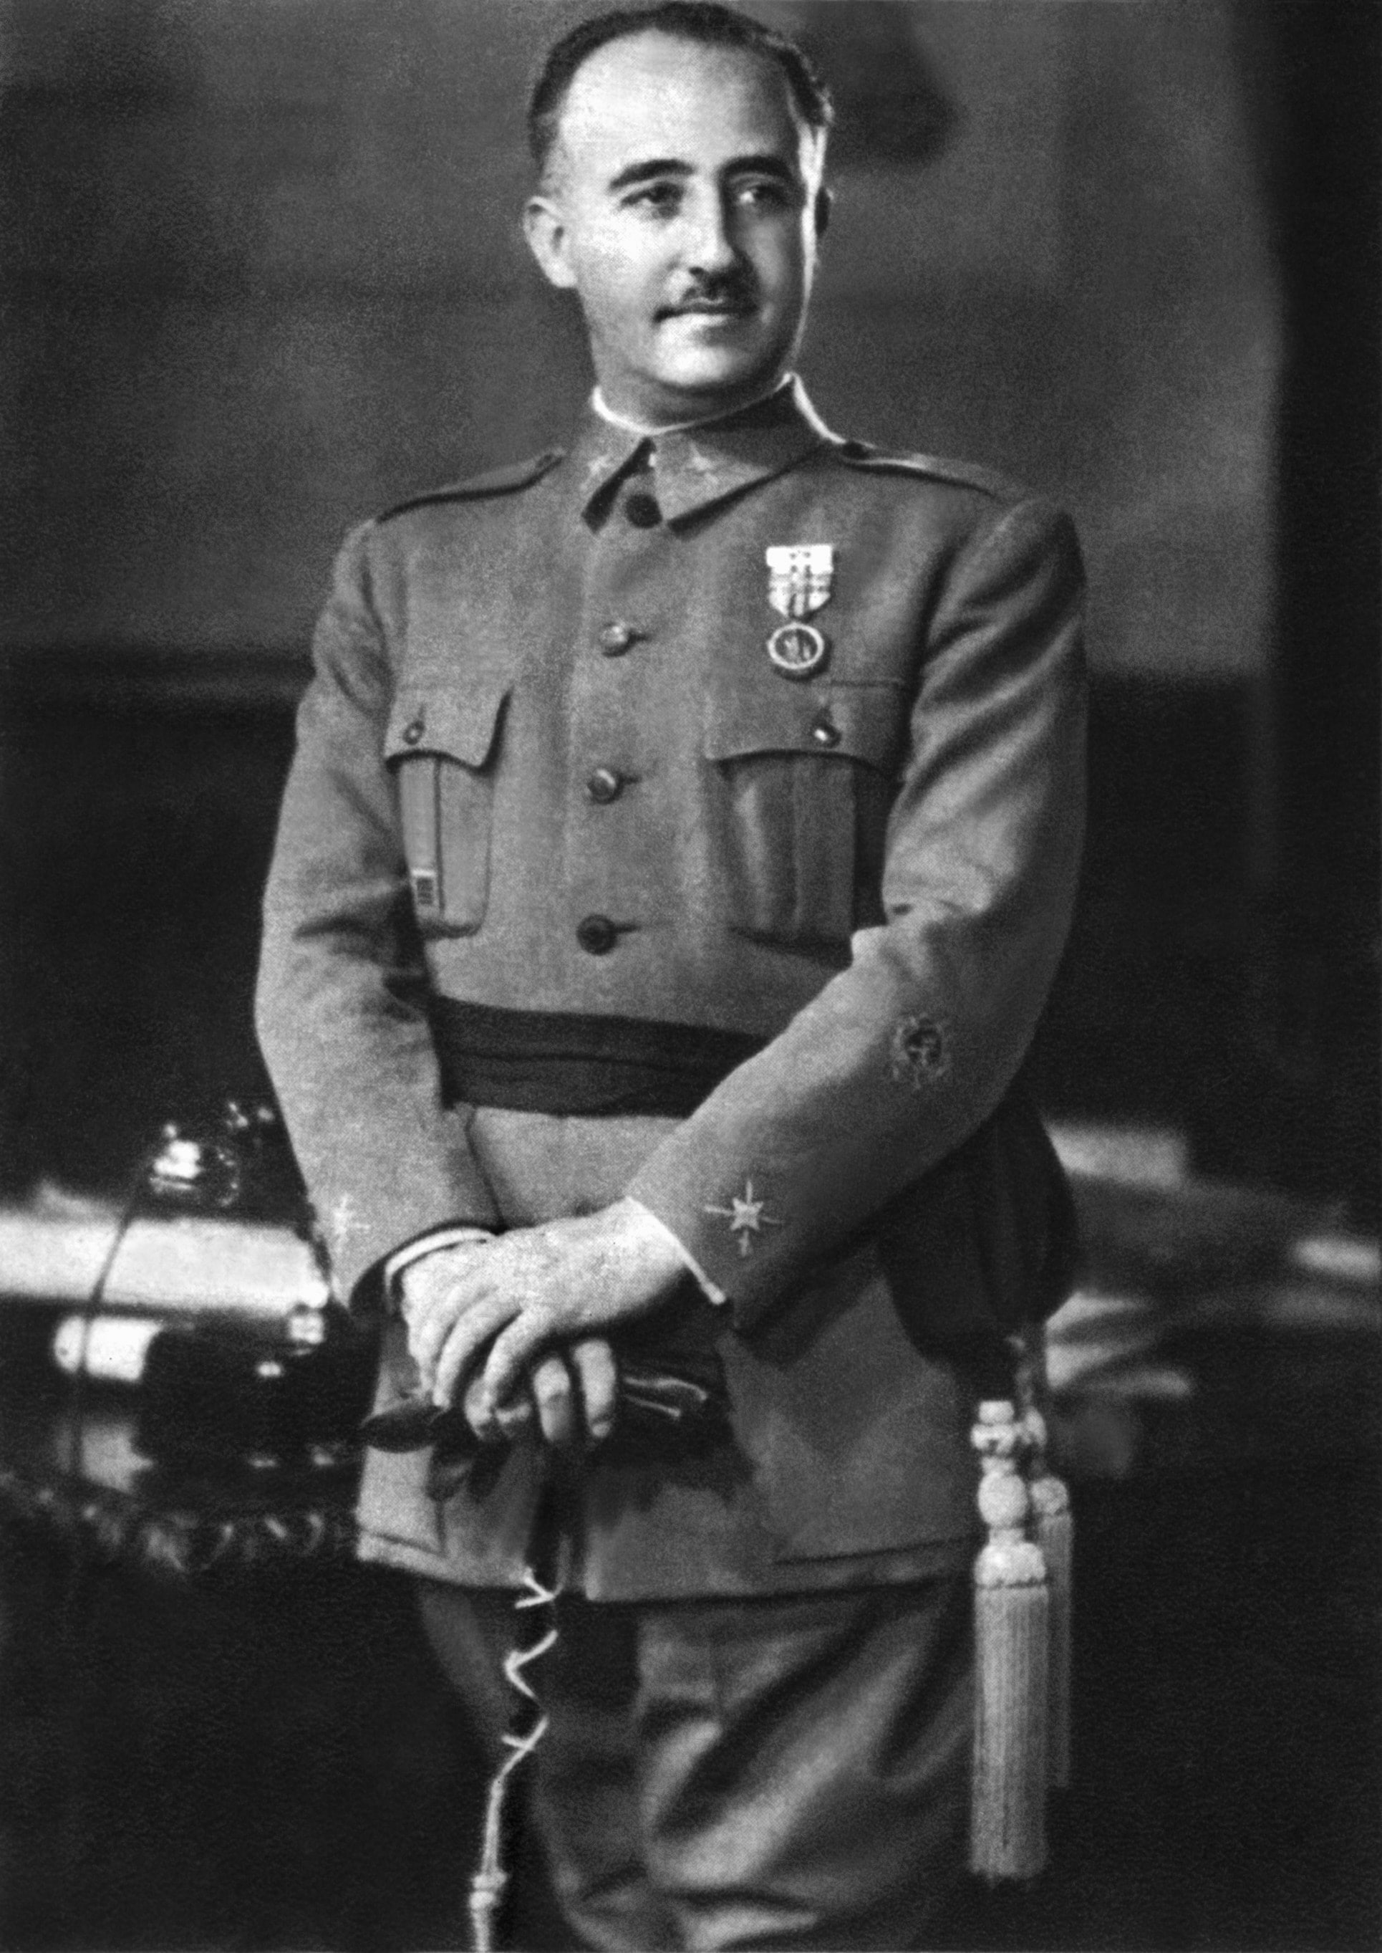
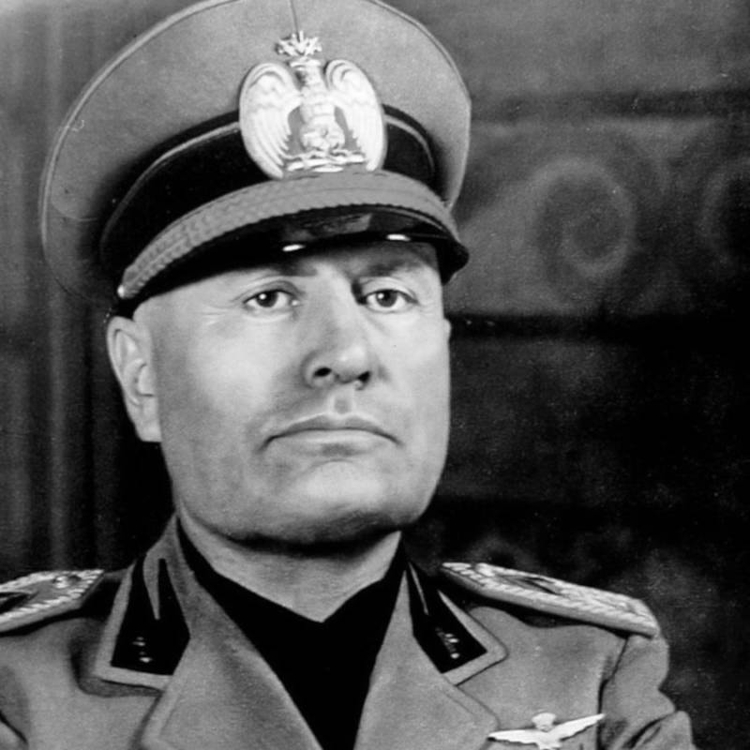
But rhetoric can CERTAINLY be bad….
6

Slide 7
LOGIC DIFFERS FROM RHETORIC BUT WE NEED A MORE PRECISE DEFINITION OF WHAT IS AN ARGUMENT:
arguments provide reasons for thinking a claim is true.
A claim does not constitute an argument.
An argument needs more than one claim to be an argument
7

Slide 8
Difference argument/claims?
Consider (CLAIMS):
1.It’s going to rain later.
2.Philosophers are odd, unworldly people.
Compare those with: (ARGUMENTS)
1a. It’s going to rain later, I know because I heard the weather forecast on the radio and it’s usually reliable.
2a. I’ve met a few philosophers in my time and they’ve always been strange people, heads in the clouds, not really in touch with the real world. Philosophers are odd, unworldly people.
8

Slide 9
Argument = gives some support for the claim!
It is not simply a statement regarding a certain fact
9

Slide 10
ELEMENTS IN ARGUMENTS:
arguments are made of Premises and Conclusions
Conclusion = claim we want others to accept
Premises = the claims giving us reasons for accepting the conclusion
10

Slide 11
Premises and conclusions can be either true or false
But an argument can only be valid or invalid.
11

Slide 12
An argument is LOGICALLY valid if and only if it takes a form that makes it impossible for the premises to be true and the conclusion to be false.
12

Slide 13

An argument can be expressed by different sets of sentences
but it will always have one and only one conclusion.
13

Slide 14
SO WE KNOW WHAT ARGUMENTS ARE, HOW DO WE ANALYSE THEM?
we have to perform 3 steps:
Identify the argument
-Is it really an argument?
14

Slide 15
2. Reconstruct the argument
-map out the steps and form of the argument’s reasoning.
15

Slide 16
3. Evaluate the argument
-we ask what’s good about the argument, what’s bad about it, how it can be improved, and whether it is justified
16

Slide 17
Consider the following argument:
Helping someone to commit suicide is the same as murder. Murder is wrong. Therefore, helping someone to commit suicide is wrong.
We can STANDARDIZE it -→
17

Slide 18
P1. Helping someone to commit suicide is the same as murder (major)
P2. Murder is wrong (minor)
-------------------------------------- (therefore)
C. helping someone to commit suicide is wrong
This is what we call argument reconstruction.
18

Slide 19
To assess an argument is crucial to understand the intentions behind it.
Understanding the context is often crucial
19

Slide 20

STEP 1. Identify the conclusion
Watch for words like: Therefore, hence, thus, it can be concluded that, so ..
20

Slide 21
Other indicator words
because, follows from the fact that, is established by , is implied by..
21

Slide 22

REMEMBER:
If there are conclusion indicators you can try to add them
22

Slide 23

Consider the following passage:
‘I think that Svetlana should sue the local council. They have admitted that they were negligent in not mending the cracked pavement that she tripped over when she broke her ankle and that’s sufficient grounds for compensation’.
23

Slide 24
STEP 2. Identify the premises and how they are related
P1) The local council has admitted negligence.
P2) An admission of negligence is sufficient grounds for compensating an injured party
.-----------[thus] – added indicator (STEP3)
C) The local council should compensate Svetlana.
STEP 4. Evaluate the argument
24

Slide 25
So far we discussed easy cases where the conclusions were explicit;
but there are cases in which the conclusions are hidden …..
25

Slide 26

…In these cases the conclusion of an argument may serve as a premise for a subsequent argument.
we talk of intermediate conclusions
26

Slide 27

Here is an example
P1) Fido is a dog.
P2) All dogs are mammals.
--------
C*) Fido is a mammal.
P3) All mammals are warm-blooded.
--------
C) Fido is warm-blooded.
This is know as extended argument!
27

Slide 28
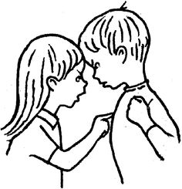
An extended argument is an argument that is made up of two or more other sub-arguments
Reconstructing and evaluating such arguments is more difficult
In this course we will be mostly concerned with such arguments
28

Slide 29
INTERPRETING ARGUMENTS
(PROBLEMS)
linguistic phenomena can make the task of identifying and interpreting arguments more difficult
Next we focus on these phenomena
29

Slide 30
Ambiguity
A sentence is ambiguous in a given context when there is more than one possible way of interpreting it in that context
30

Slide 31
1a. Lexical ambiguity
‘He is looking for a match’:
He is looking for a small stick of wood with an inflammable tip
He is looking for another one the same
He is looking for wants a game of tennis (or some such)
31

Slide 32

1b. Syntactic ambiguity
For example ‘33-year old Mrs Jones admitted to dangerous driving in Leeds Crown Court yesterday.’ could mean either of the following:
In Leeds Crown Court yesterday Mrs Jones admitted to dangerous driving
Yesterday Mrs Jones admitted to driving dangerously inside Leeds Crown Court
32

Slide 33
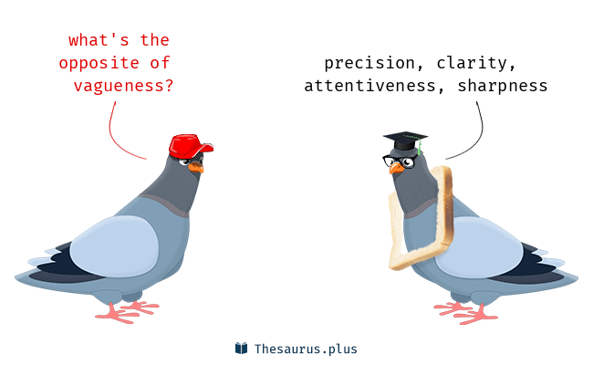
2. Vagueness is a property of words and phrases. Mistaken for ambiguity but vague means lacking precision or detail
33

Slide 34
Take the word liberal
Belief in a permissive society;
Belief in freedom of speech, of association, of choice;
Belief that certain restrictive laws should be relaxed;
Belief that the state should interfere as little as possible in citizens’ lives;
Believe in laissez faire economic policies;
Supports for the Liberal party;
Not strict;
Politically left wing;
Soft on crime;
etc
34

Slide 35
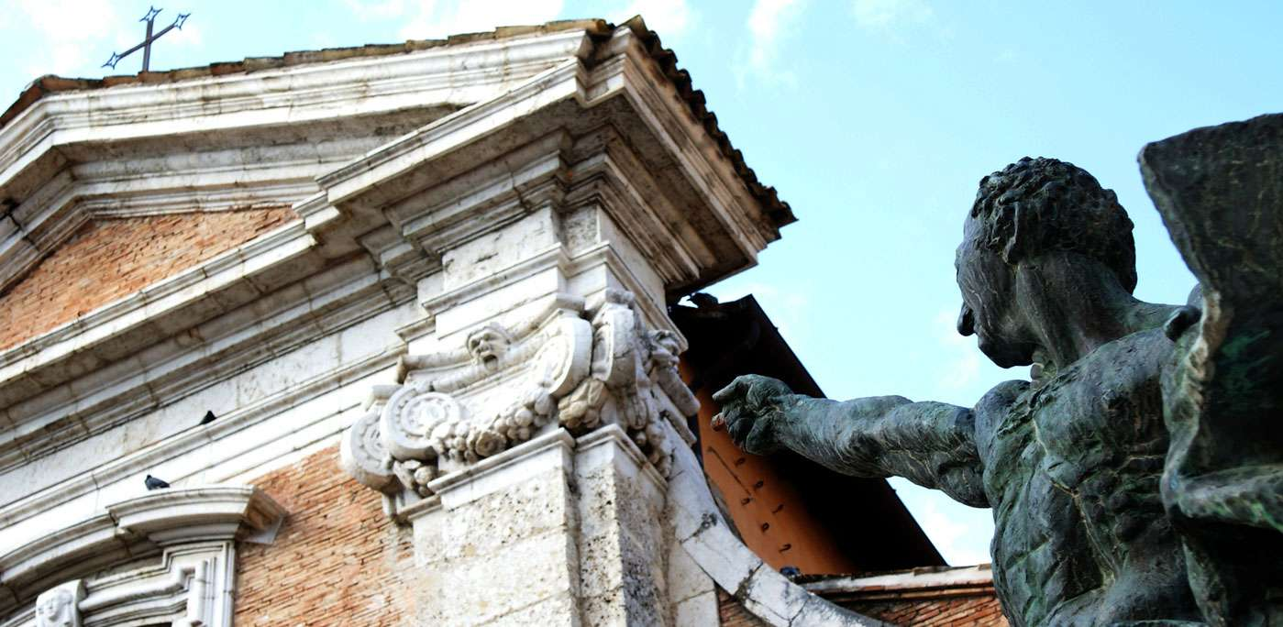
3. Rhetorical questions are not really used to ask a question, but to make a point in an indirect way.
35

Slide 36
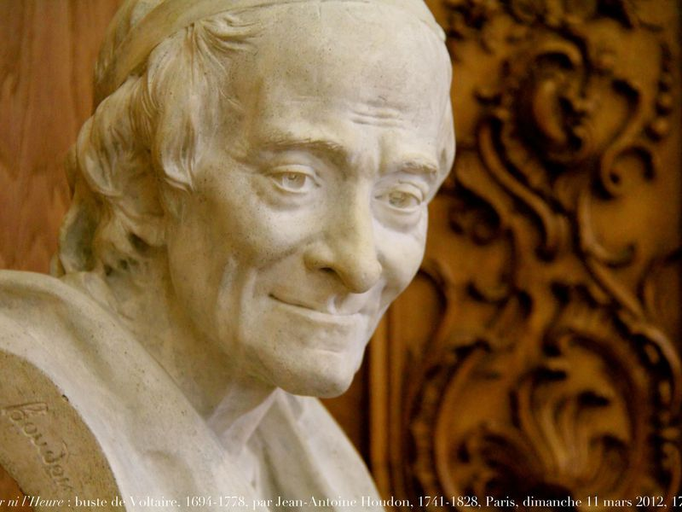
Consider the following example:
Should my right to freedom of speech be limited just because you disagree with me?
36

Slide 37
We could rewrite the rhetorical question as a declarative sentence:
My right to freedom of speech should not be limited just because you disagree with me
Rhetorical questions hinders the logical flow of an argument, add an element of distraction
37

Slide 38
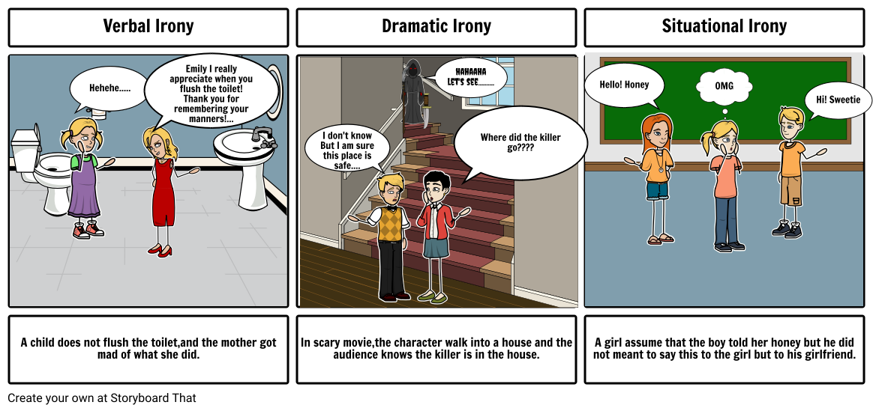
4. Irony. takes the form of language that, taken literally, would convey the opposite of what they wish to convey
38

Slide 39

5. Implicitly relative sentences
Consider these two examples
1. She (my cousin) earns an above average salary.
2. My aunt is a fast runner
39

Slide 40



1. What is the reference group?
40

Slide 41
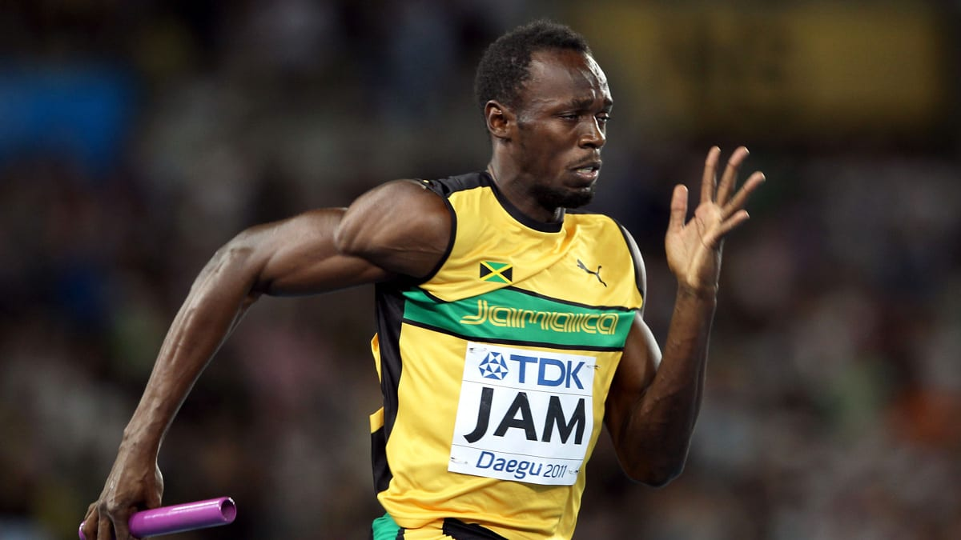


Or consider the one about my aunt
41

Slide 42
ANOTHER SOURCE OF PROBLEMS FOR ARGUMENT INTERPRETATION
6. Quantifiers = words such as ‘all, some, few, nearly all, lots of, most , always’.
42

Slide 43
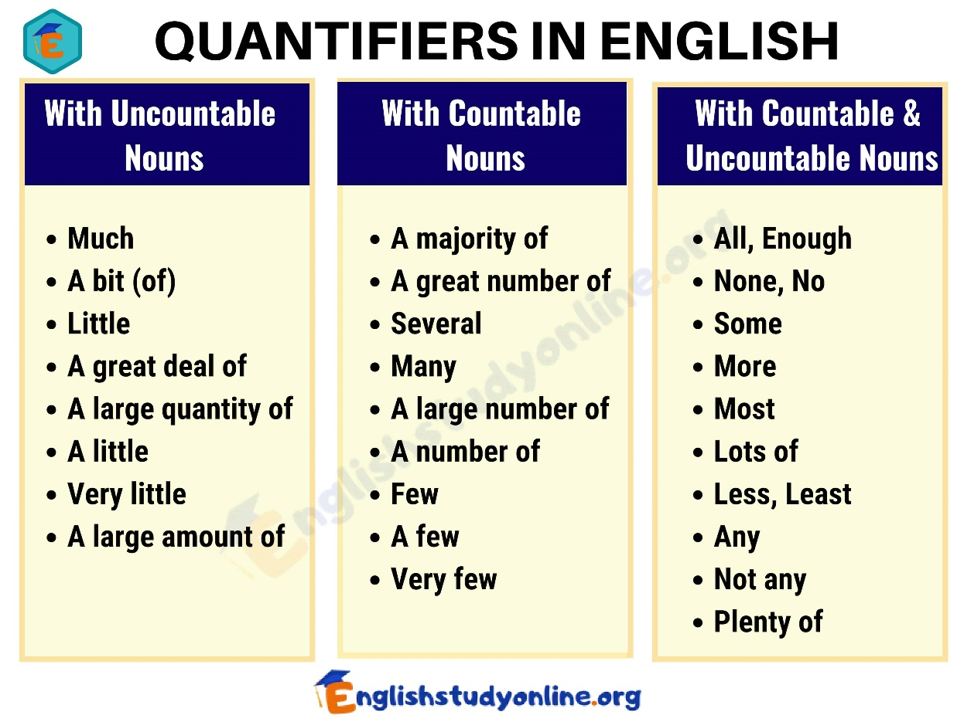
Problems with Quantifiers
1. Vague
2. Lead to false generalisations
3. Not precise
43

Slide 44
WHAT WE LEARNED TODAY:
1. difference between rhetoric and logic
2 difference between a claim and an argument
3 what is an argument and what are its components
4. what is an extended argument
5. how we can identify, reconstruct, and assess an argument
6. how to interpret an argument (ambiguity, vagueness, rhetorical questions, irony, implicit relative statement, quantifiers)
44

